Slide 1

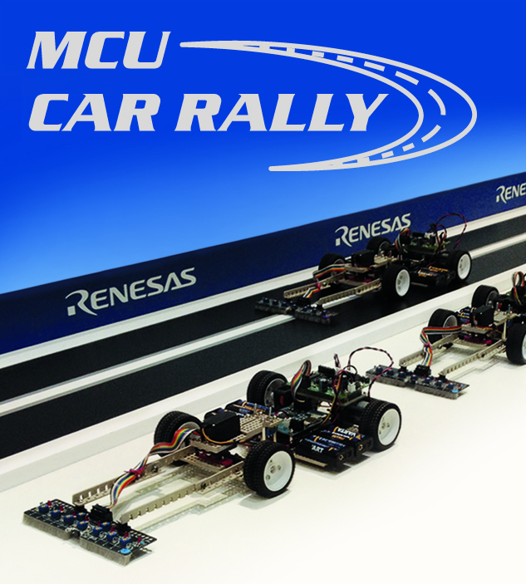
Renesas MCU Car Rally 2018
Faculty of Computing, Engineering and Science
University of South Wales – 2017/18
MEng Group Project
Weekly Report
Students:
13013521 Thomas Brown – MEng Electrical and Electronic Engineering
15021106 Kayin Templar– MEng Electrical and Electronic Engineering
14031329 Miguel Santos – MEng Computer Systems Engineering
Lecturer:
Prof Gouping Liu

Slide 2
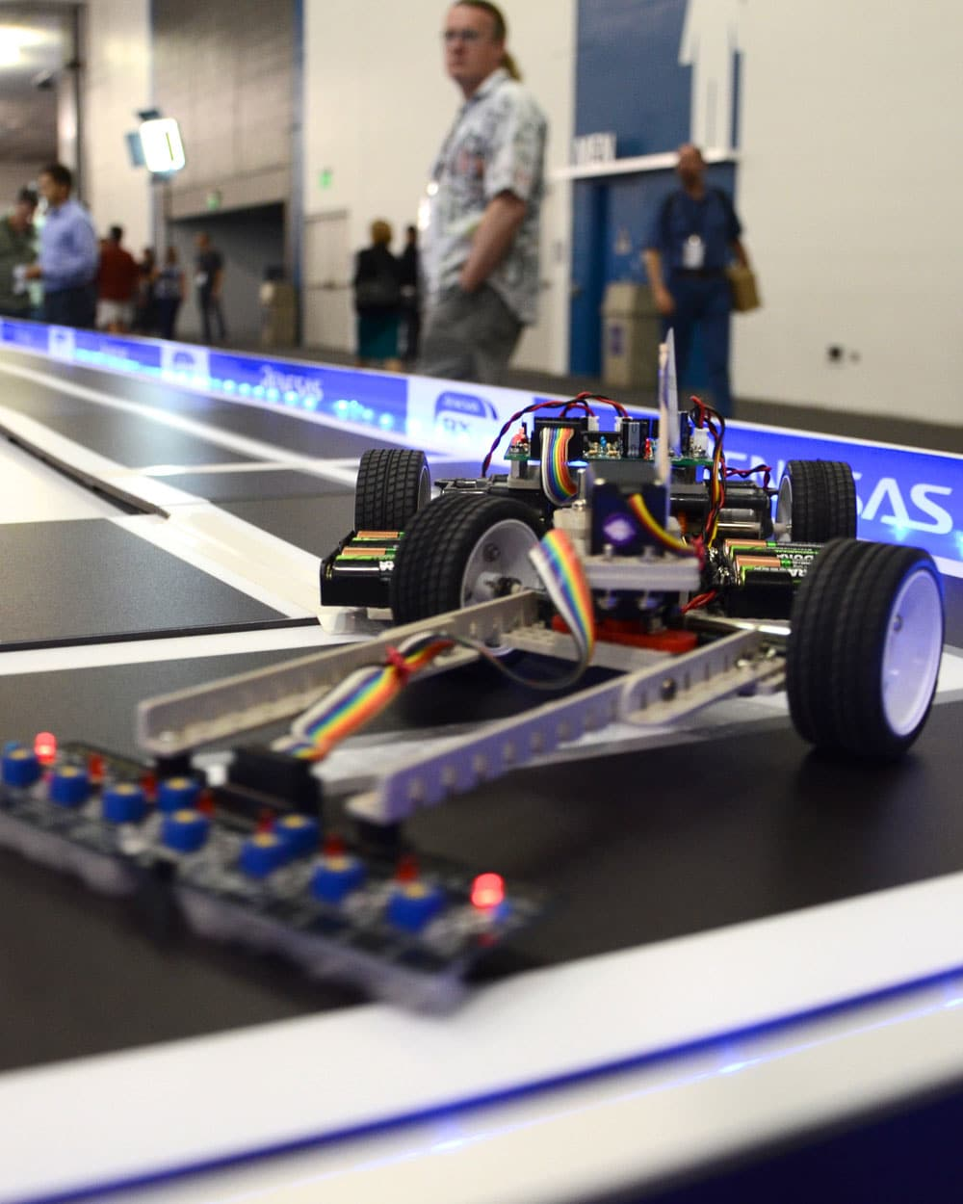
Week 7 – 1 November 2017
This week’s developments
Next week…
MEng Group Project – Renesas MCU Car Rally 2017/18

Slide 3
This week’s developments
This week, we worked on:
Improvements on the wireless communication protocol
Improved the standard I/O of the microcontroller
Addition of a basic command line interface
A plan for testing the Power Performance and the PID controller
Bill of Materials (BOM)
MEng Group Project – Renesas MCU Car Rally 2017/18

Slide 4
This week’s developments - detailed
Regarding the wireless communication protocol…
As reported from last week, a simple communication protocol has been implemented to allow meaningful and efficient transmission of accurate data through the Bluetooth module.
This is being done through the transmission of packets, which can take up any length in bytes.
However, we lost the capability to transmit raw data in the form of a string (unless the string is encapsulated inside a packet first).
Because of this, the protocol had to be improved to allow communication using both methods (with or without packets).
The benefit of this is to allow the user to control the car without the Java application; he can now open up a terminal console and control the car from there.
MEng Group Project – Renesas MCU Car Rally 2017/18

Slide 5
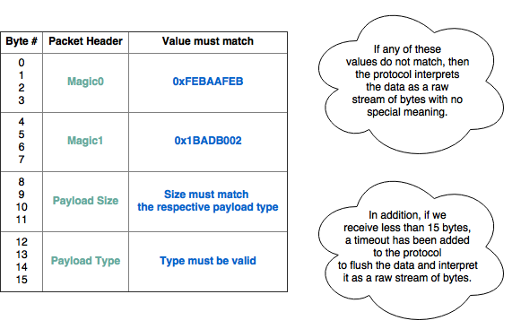
This week’s developments - detailed
The minor changes on the protocol are quite simple in terms of implementation. Specifically, the protocol buffers the incoming data and interprets the packet header. The result of the interpretation is what allows the protocol to switch modes (raw/packet mode).
MEng Group Project – Renesas MCU Car Rally 2017/18

Slide 6
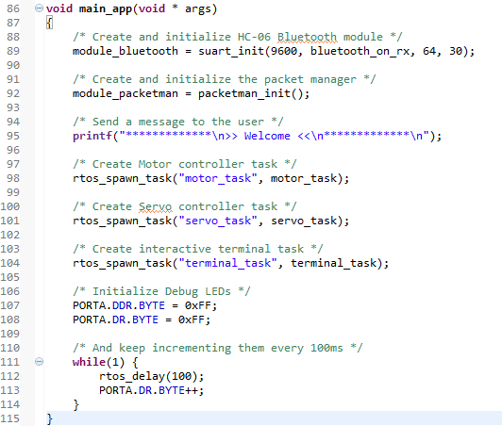
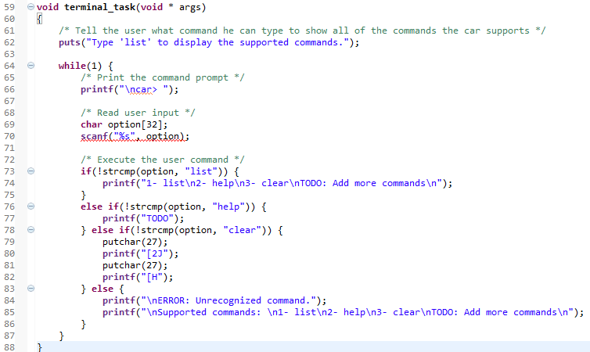
This week’s developments - detailed
Regarding the microcontroller’s standard I/O…
It is now possible to use all of the I/O functions provided by the C language.
This includes printf(), scanf(), puts(), putchar(), etc…
MEng Group Project – Renesas MCU Car Rally 2017/18

Slide 7
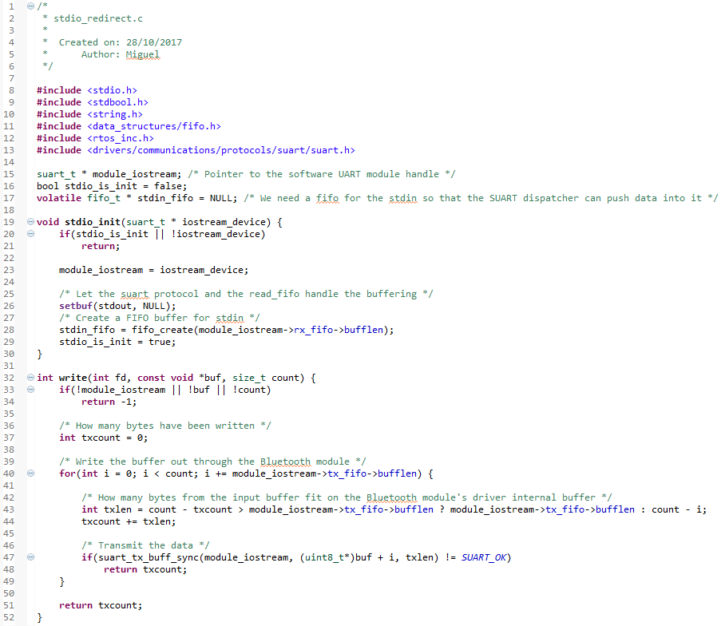
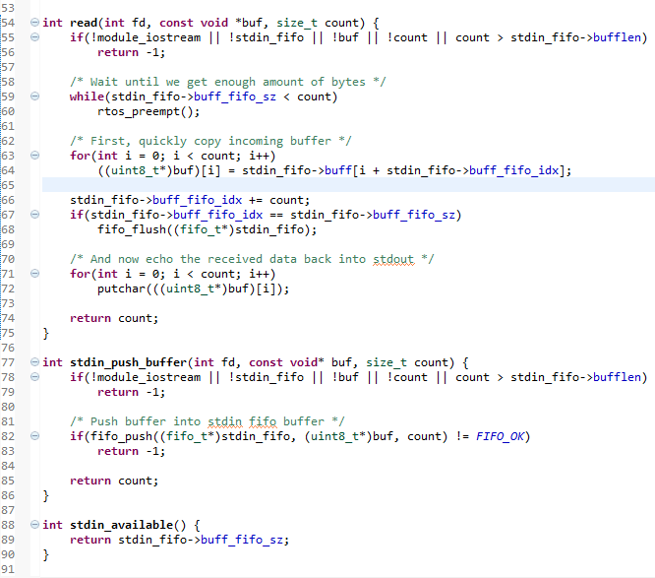
This week’s developments - detailed
This was done by routing all of the I/O through the special functions write() and read().
MEng Group Project – Renesas MCU Car Rally 2017/18

Slide 8
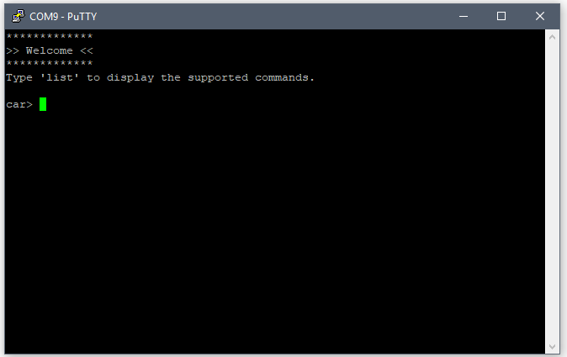
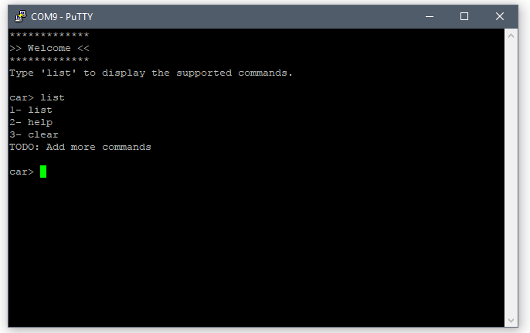
This week’s developments - detailed
Since we now have access to these functions, we get the ability to create an interactive user interface, such as the one below.
MEng Group Project – Renesas MCU Car Rally 2017/18

Slide 9
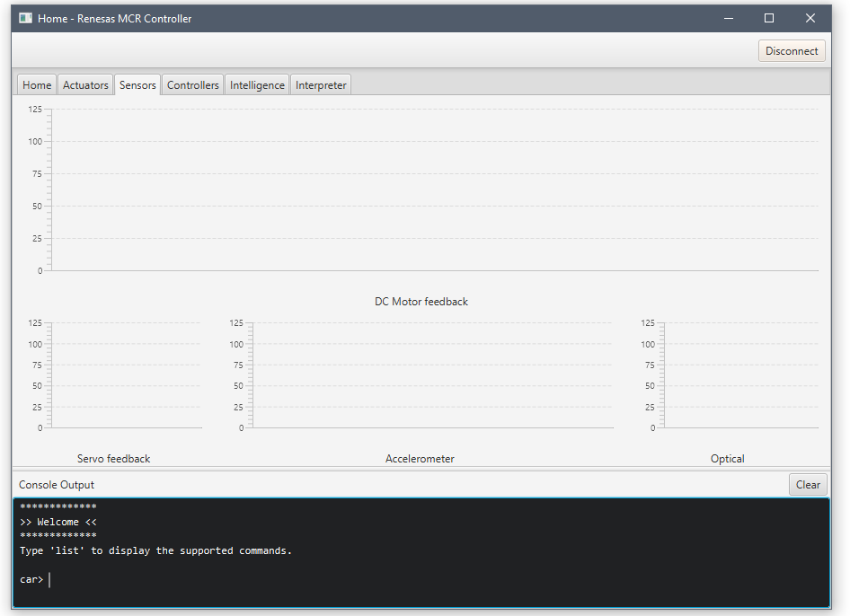
This week’s developments - detailed
And because the protocol now supports both raw data transmission and packet transmission, we can use the Java application seamlessly without any type of conversion.
MEng Group Project – Renesas MCU Car Rally 2017/18

Slide 10
This week’s developments - detailed
Power Performance Testing for battery
Treadmill for testing has been found
As soon as we are ready we can test the current draw of the car
MEng Group Project – Renesas MCU Car Rally 2017/18

Slide 11
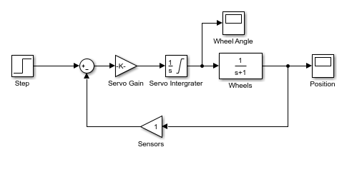
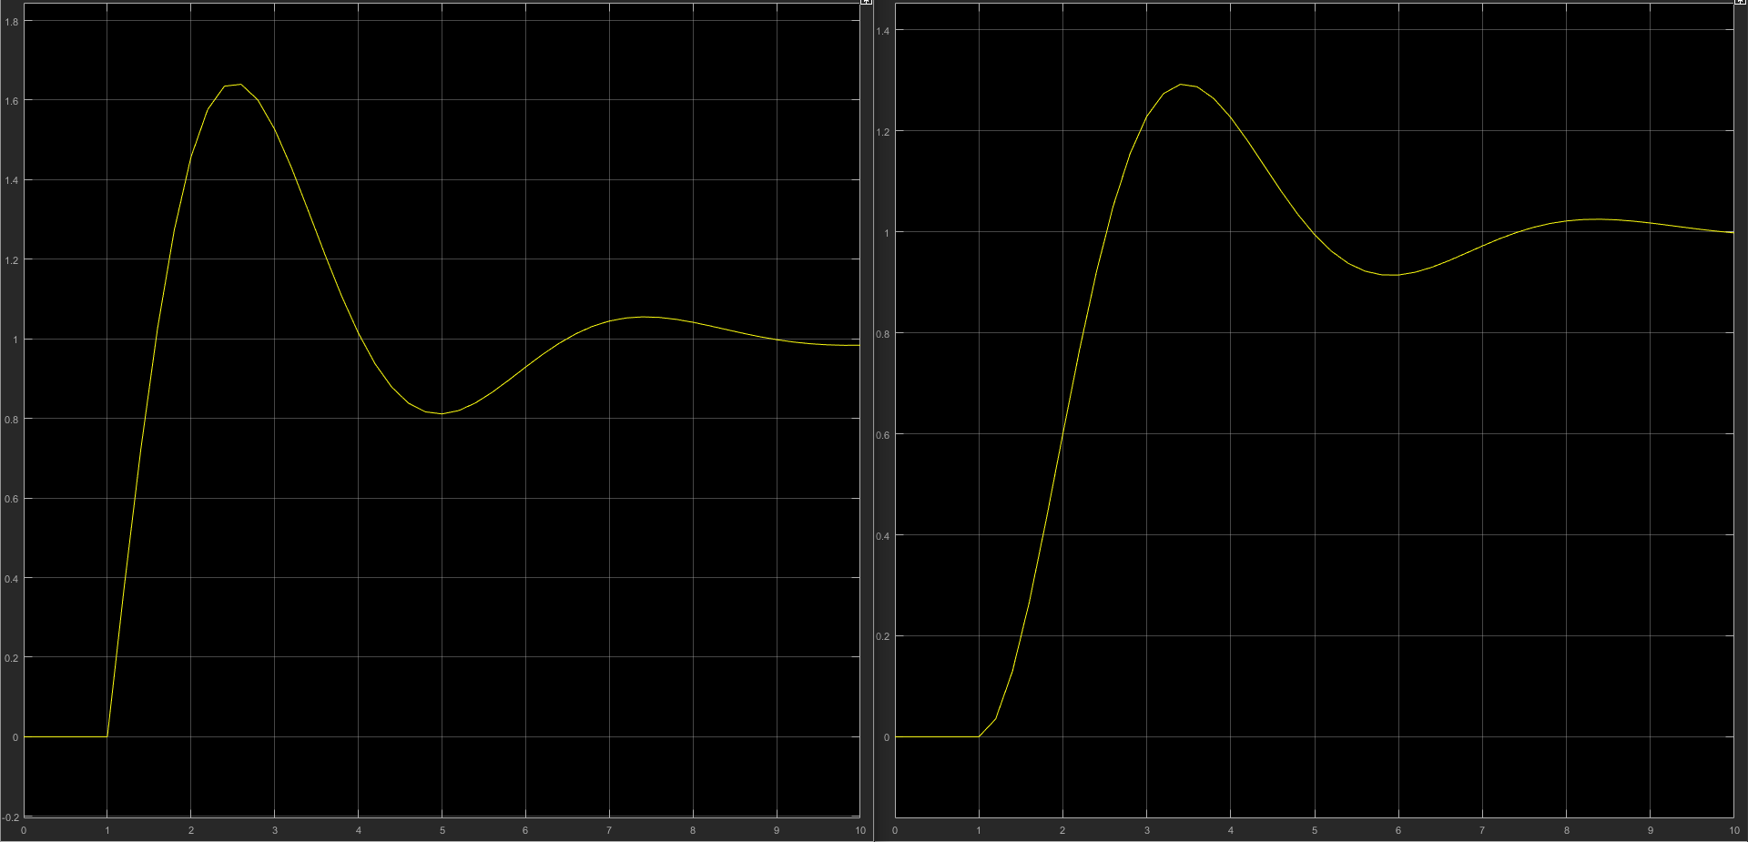
This week’s developments - detailed
PID testing plan
Create code that logs error from line
Give the servo inputs from 0° to 60°
Plot error/time response to different servo input
This will give a model to build the PID around
MEng Group Project – Renesas MCU Car Rally 2017/18

Slide 12
This week’s developments - detailed
Finally, the last development of this week was the Bill of Materials that should cover every component in this project.
Item | Number | Use | Cost/£
Honeywell SS411A, Bipolar Hall Effect Sensor, 3-Pin | 2 | Speed Control | 2.58
ADXL335 - 5V ready triple-axis accelerometer | 1 | Speed Control | 11.24
LED | 1 | Battery Warning Light | 0.05
5mm Neodymium Magnets | 1 | Speed Control | 5.24
Battery (Unknown) | 1 | Power | N/A
 |  |  | 19.11
MEng Group Project – Renesas MCU Car Rally 2017/18

Slide 13
Next week…
This coming week will be dedicated to:
Assembling and soldering the car
Implementing drivers for the optical sensors
Completing/improving the theory for the PID controller
Beginning the implementation of the PID controller in software
Discovering the best battery using the treadmill
Finishing up the communication protocol
Completing the Java application (the graphs and plots are still not being used)
MEng Group Project – Renesas MCU Car Rally 2017/18

Slide 14
Questions?

